Slide 1
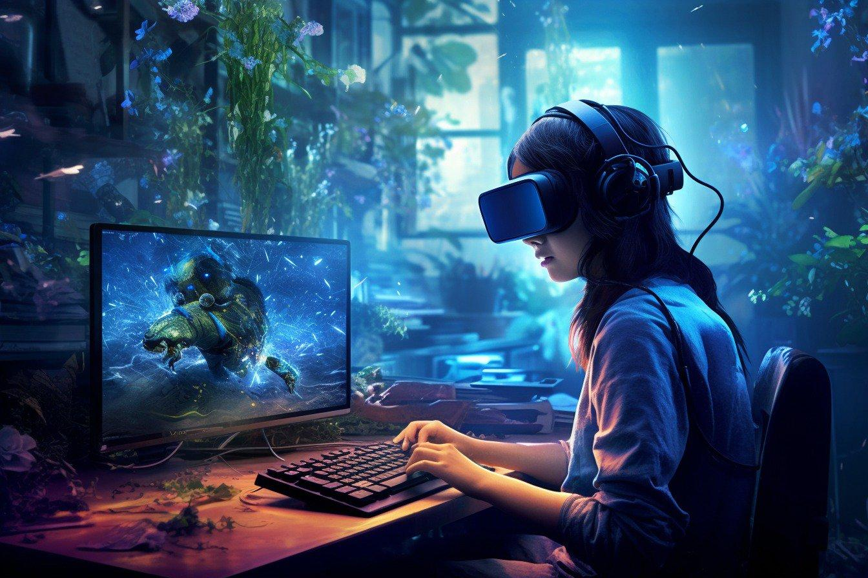
AI IN GAMING:
REVOLUTIONIZING
THE INDUSTRY
AI is changing the landscape of gaming, from development to gameplay and beyond.

Slide 2
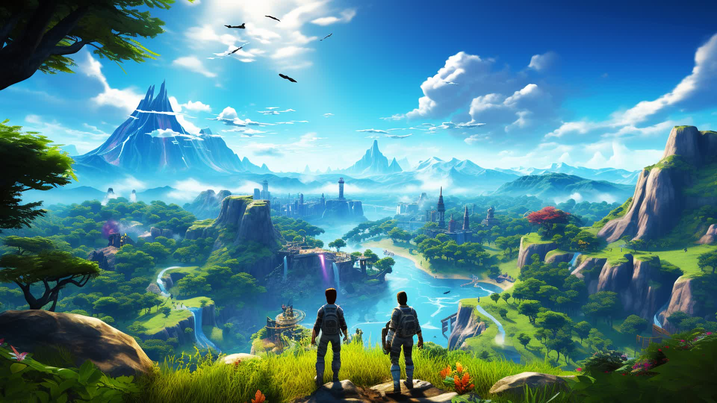
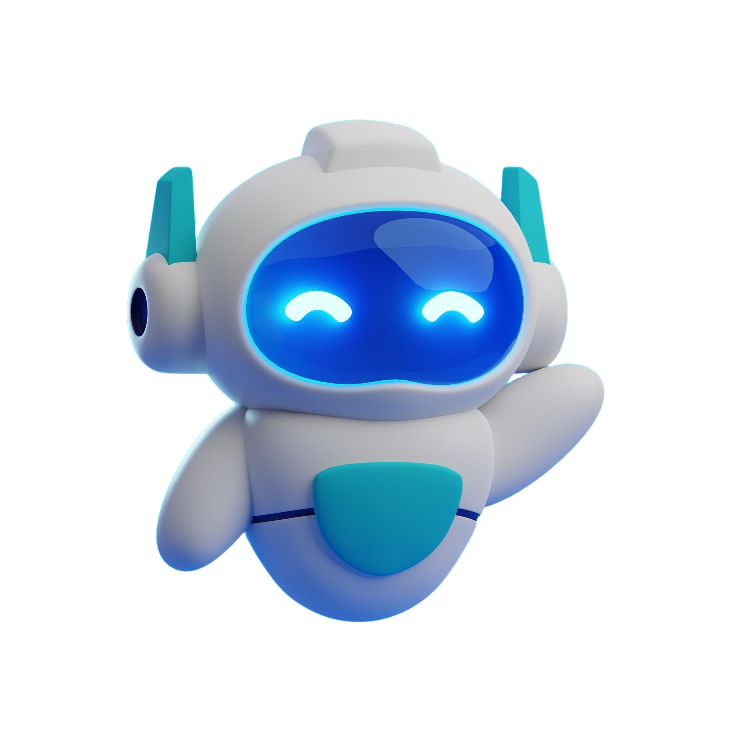
Table of
Contents
What is AI ?
1
AI in Gaming: Role, Benefits, Application
2
NPCs and Game world Behavior
3
AI in Chess
4
Challenges and Limitations
5
Future Trends And Conclusion
6

Slide 3
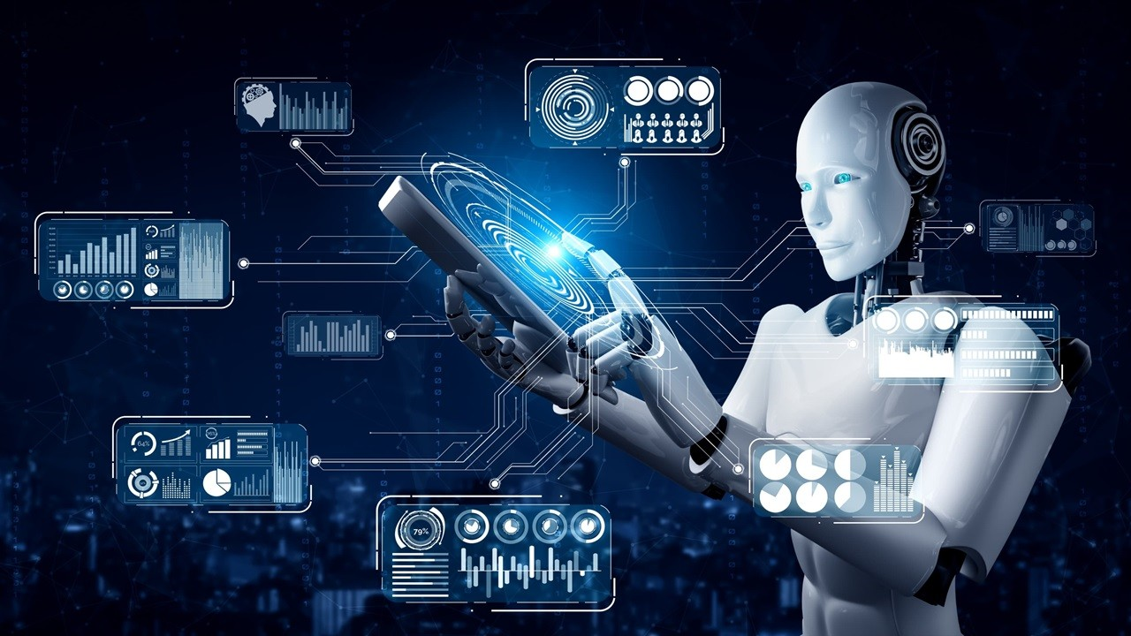
What is....
Artificial
Intelligence?
Artificial Intelligence (AI) refers to the development of computer systems capable of performing tasks that typically require human intelligence.
These tasks include learning, reasoning, problem-solving, perception, and language understanding.

Slide 4
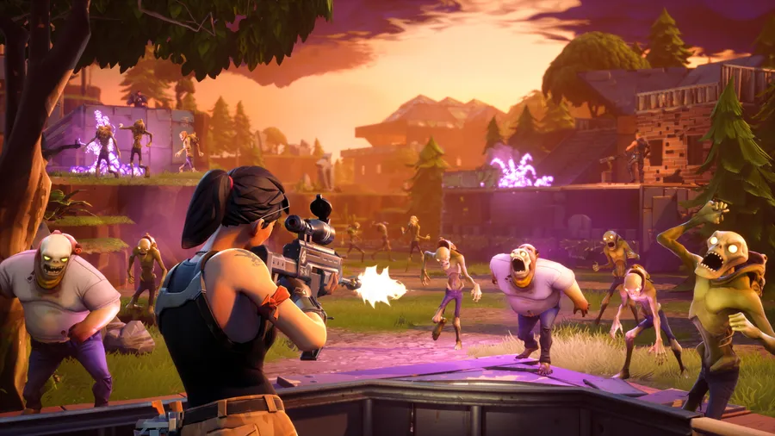
What is....
Ai in Gaming?
Artificial intelligence by having gaming means making use of artificial intelligence practices to generate more dynamic, adaptive and gripping video game experiences.
It is as if it fills the void that exists the virtual environment to make interactions and gameplay more natural.

Slide 5
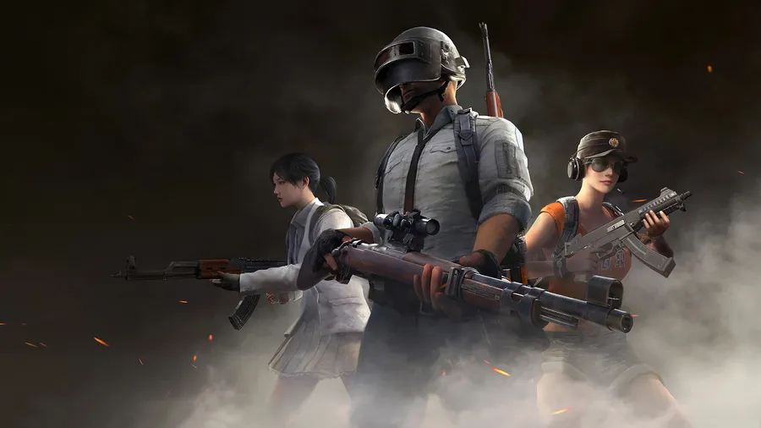
Ai in Gaming….
What it does?
01
Intelligent NPCs:
AI manages non-player characters (NPCs) in order to increase the number one feature - human behavior. In the mindset picture stand your enemies, not an attack line, but flanks. On the other hand, you as a teammate have to support your friends using strategic skills, too.

Slide 6
Ai in Gaming….
What it does?
01
02
Intelligent NPCs:
AI manages non-player characters (NPCs) in order to increase the number one feature - human behavior. In the mindset picture stand your enemies, not an attack line, but flanks. On the other hand, you as a teammate have to support your friends using strategic skills, too.
Dynamic Game Worlds:
AI can be utilized to create a game world, a quest storyline as well as a storyline scenarios procedurally. The fact here is that you have the entire world to play around with, which means that anything is possible and the outcome is unpredictable and full of thrills.

Slide 7
Ai in Gaming….
What it does?
01
02
03
Intelligent NPCs:
AI manages non-player characters (NPCs) in order to increase the number one feature - human behavior. In the mindset picture stand your enemies, not an attack line, but flanks. On the other hand, you as a teammate have to support your friends using strategic skills, too.
Dynamic Game Worlds:
AI can be utilized to create a game world, a quest storyline as well as a storyline scenarios procedurally. The fact here is that you have the entire world to play around with, which means that anything is possible and the outcome is unpredictable and full of thrills.
Personalized Gameplay:
AI equips you by choosing the difficulty of the challenges that you face based on your current skills. An accurate level of difficulty is also maintained thus the game is not too boring nor too difficult which constantly keep the players engaged.

Slide 8
Ai in Gaming….
What it does?
01
02
03
04
Intelligent NPCs:
AI manages non-player characters (NPCs) in order to increase the number one feature - human behavior. In the mindset picture stand your enemies, not an attack line, but flanks. On the other hand, you as a teammate have to support your friends using strategic skills, too.
Dynamic Game Worlds:
AI can be utilized to create a game world, a quest storyline as well as a storyline scenarios procedurally. The fact here is that you have the entire world to play around with, which means that anything is possible and the outcome is unpredictable and full of thrills.
Personalized Gameplay:
AI equips you by choosing the difficulty of the challenges that you face based on your current skills. An accurate level of difficulty is also maintained thus the game is not too boring nor too difficult which constantly keep the players engaged.
Game Balancing:
AI algorithms may be used to look at gameplay data in order to ensure the balance of the game automatically. This mechanism checks the fairness of the session and all individuals, without exceptions, find their way to game action.

Slide 9
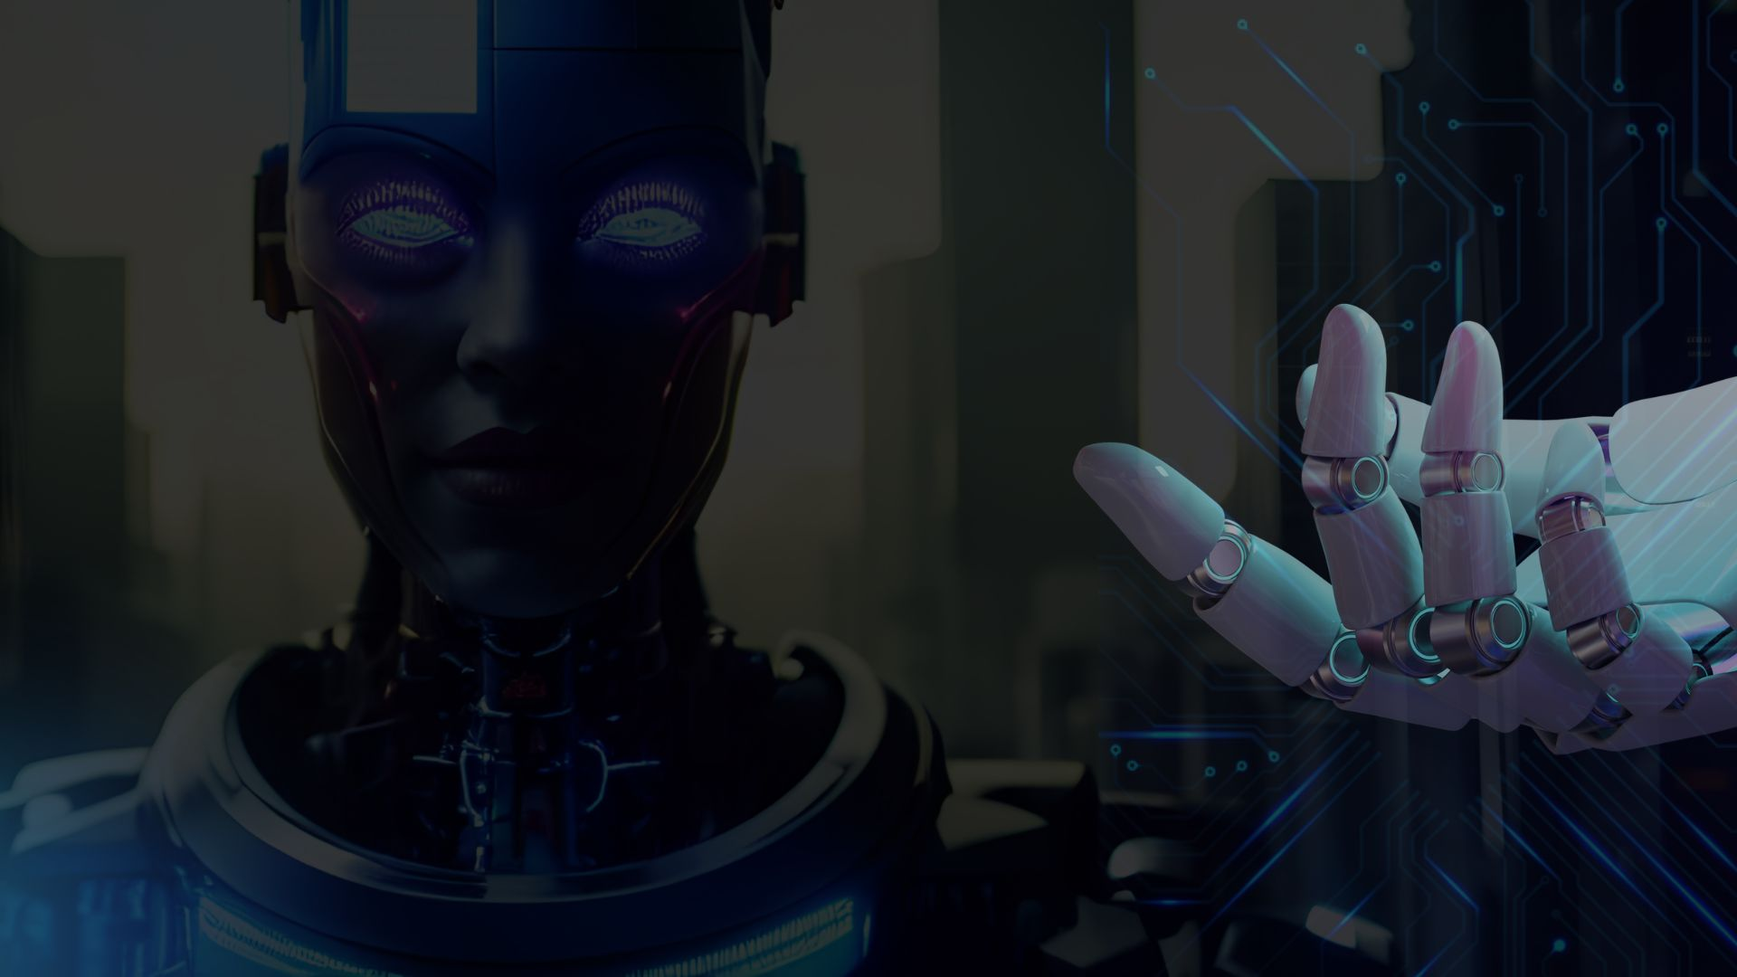

AI
Application in Gaming
AI-Powered Game Mechanics:
AI can enhance gameplay by creating dynamic enemies that adapt to player strategies, generating procedurally generated levels, and optimizing game balance.
Content and Environments:
AI can generate realistic and immersive game worlds, characters, and storylines, creating unique and ever- changing gaming experiences.
AI for Game Analytics and Testing :
AI can analyze player data, identify patterns, and optimize game design to create more engaging and balanced gaming experiences. AI can also automate game testing, saving time and resources for developers.

Slide 10
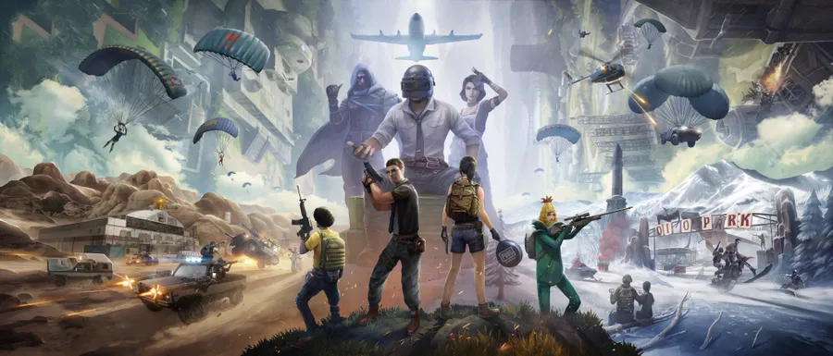
Benefits of using
Ai in Gaming….

Slide 11
Benefits of using
Ai in Gaming….
Designing levels:
AI can also be used to make a better level designed for the game to be more playable and more enjoyable for the players. It is truly a greater tool for the designers.
Cheaper labor:
AI is like cheaper labor in the games, it makes the work that is generally needed to do in gaming more and more quicker such as fixing the bugs in the game.
4) Automated Storytelling:
AI-powered storytelling allows games to generate dynamic and interactive narratives that evolve based on player choices.
2) Creative Ideas:
AI can also be used to get some ideas for the games. It is a great tool to find newer ideas as the games can quickly get repetitive.

Slide 12
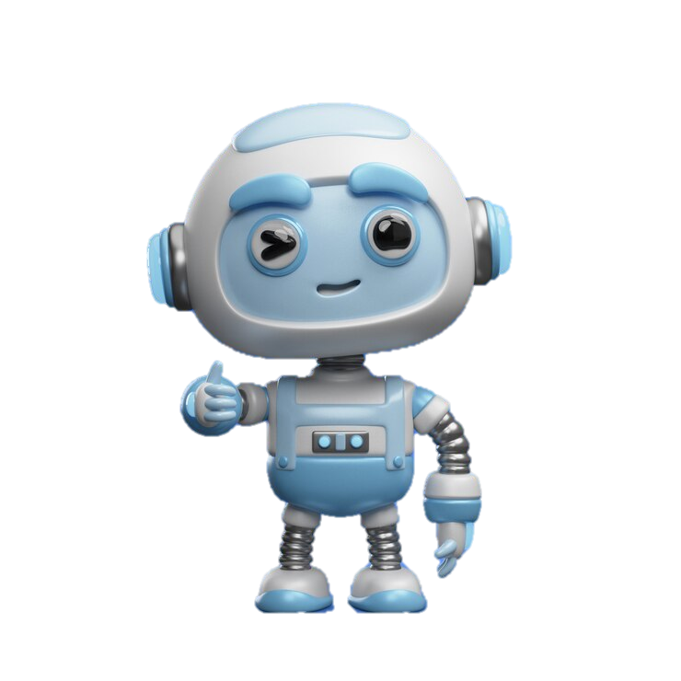
Benefits of using
Ai in Gaming….

Slide 13
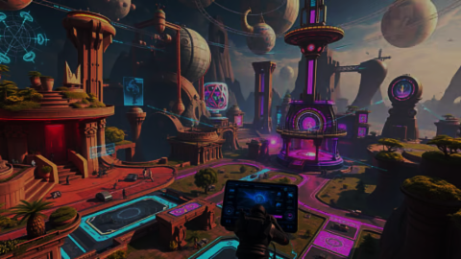


Non-Player Characters (NPCs)
Enemy AI
Ally AI
This includes progrmming of enemies to utilising the tactics and maneuvers particular to fighting durnging combat. This can be achieved, for example, by constantly slipping for a sidetrack, or taking a cover, or using suitably suitable combat tactics for the given combat.
AI can create companions that come up with strategies and actions as well as you to take down the mission objectives. AI Ally can be further developed as a character in the partner with whom the player interacts with with their unique persona and mannerisms, enhancing the gameplay and empathy.

Slide 14
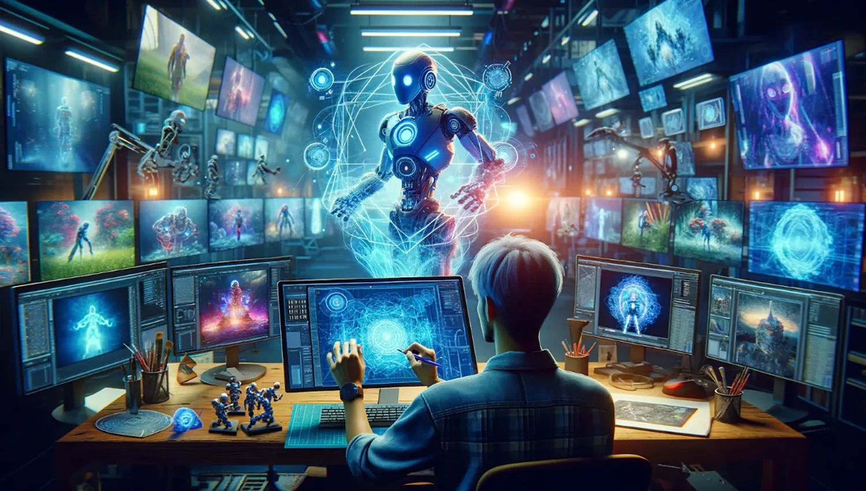

Game World Behavior
Procedural content generation:
AI can be programmed to develop interactive game worlds, progression routes, and situations. That way a new vision can be effectively communicated to the players, which guarantees that the gameplay does not lose continuity and remains thrilling.
Level design that adapts
Game balancing and optimization
AI elements could be used to design the levels that are reliant on the player actions while also depicting unique changes.
Through AI, the game will be able to analyze players’ data and instantly adapt difficulty or other parts of the game without any need for manual interference and thus it creates fun and challenging conditions for each player equally.

Slide 15
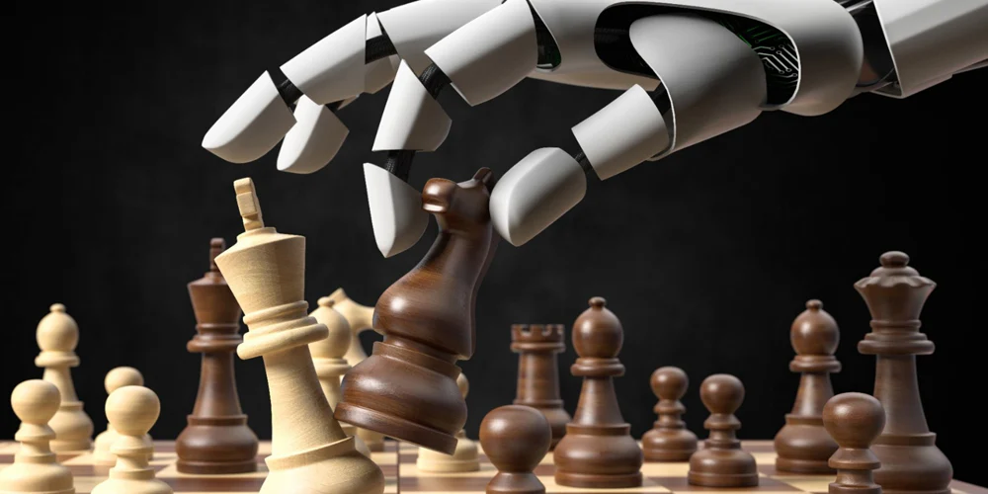
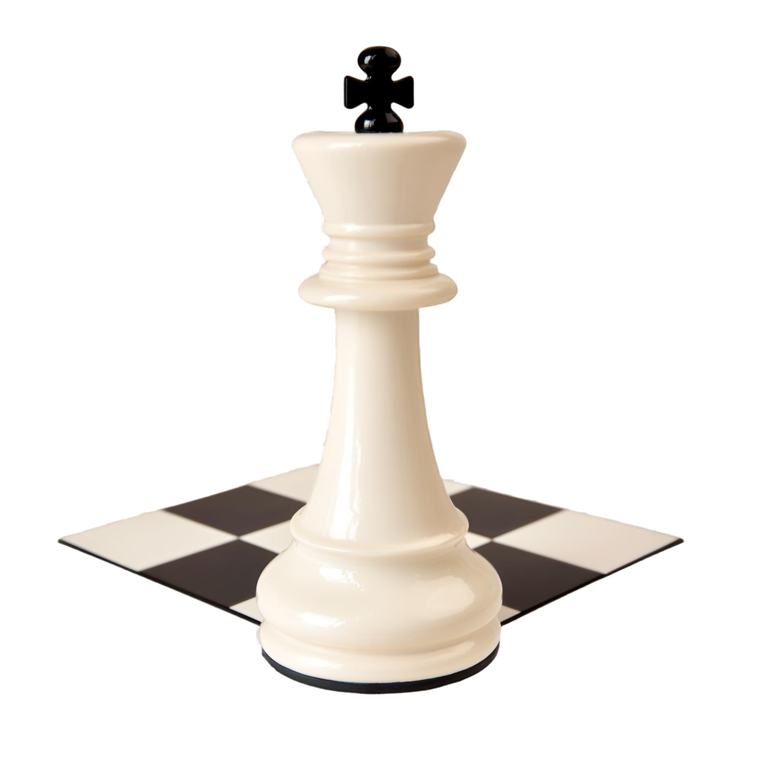
AI IN CHESS
Smart Moves, Smart Training!
Plays Like a Pro
Teaches & Improves
AI engines (Stockfish, AlphaZero) calculate the best moves instantly.
AI reviews games, corrects mistakes, and helps players learn.
Stops Cheating
Predicts Outcomes
AI tracks unusual moves to catch unfair play.
AI gives real-time insights during big matches.

Slide 16
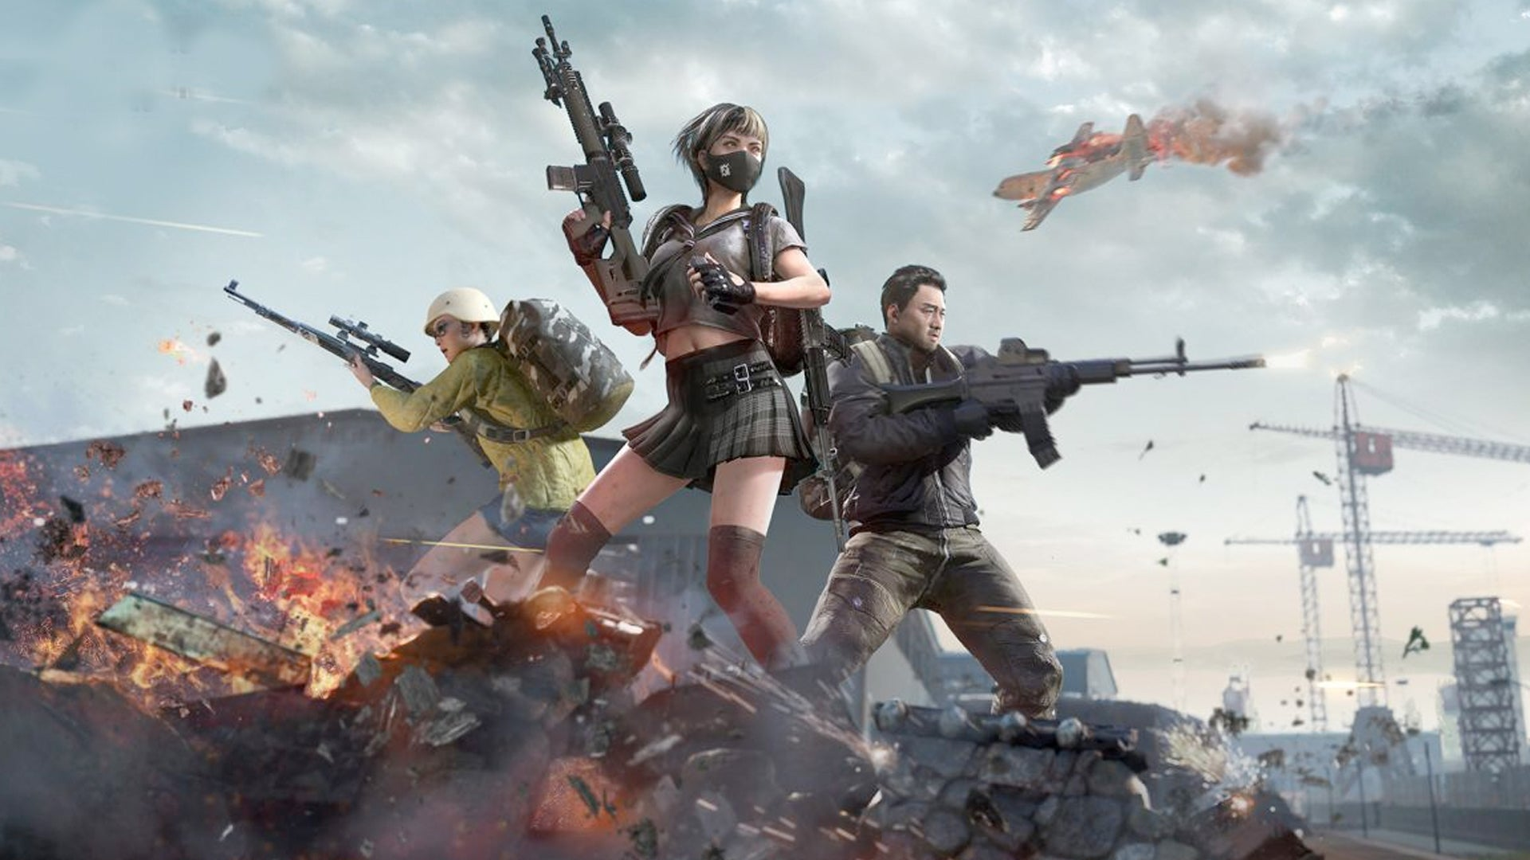


Computational Power
AI Bias and Fairness
AI algorithms require significant processing power, which can limit performance on older devices.
AI systems can inherit biases from the data they are trained on, leading to unfair or unrealistic outcomes.
Data Requirements
Human-like Behavior
Training AI models require vast amounts of data, which can be expensive and time-consuming to collect and process.
Creating AI that truly replicates human behavior remains a significant challenge.
Challenges
And Limitations

Slide 17
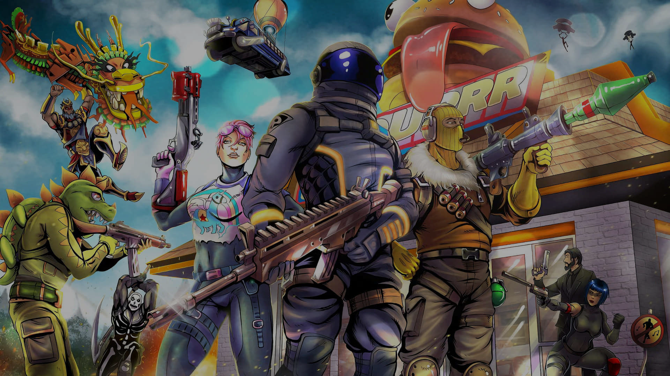

Future Trends
Emotionally Intelligent AI opponents
AI will detect the player's emotions and adjust in-game responses accordingly.
Cloud Gaming & AI Integration
AI will optimize game streaming and reduce latency for smoother gameplay.
AI-Driven Esports
AI will analyze gameplay strategies and assist in coaching players.

Slide 18
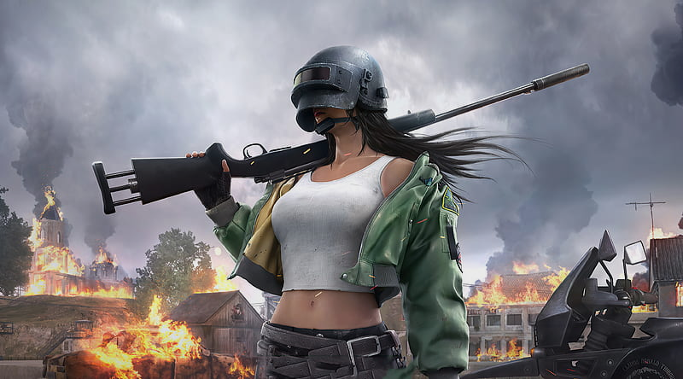


Conclusion
AI with the growth of the time, has gone more and more advanced. It has been used in various areas of the gaming industry and the use of AI will only grow in the gaming industry.
The gaming industry is going through a drastic change, now AI is used in various areas and is not limited to a particular area. It is a great opportunity for gamers to use AI to make gaming more and more interesting and more real.

Slide 19
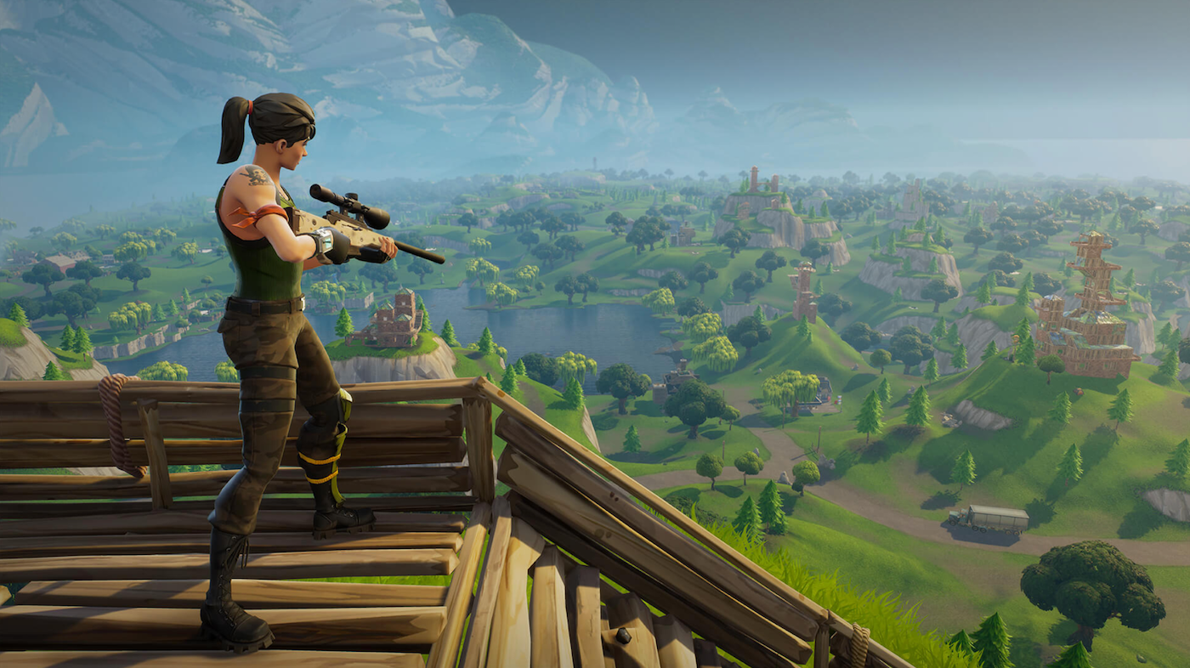
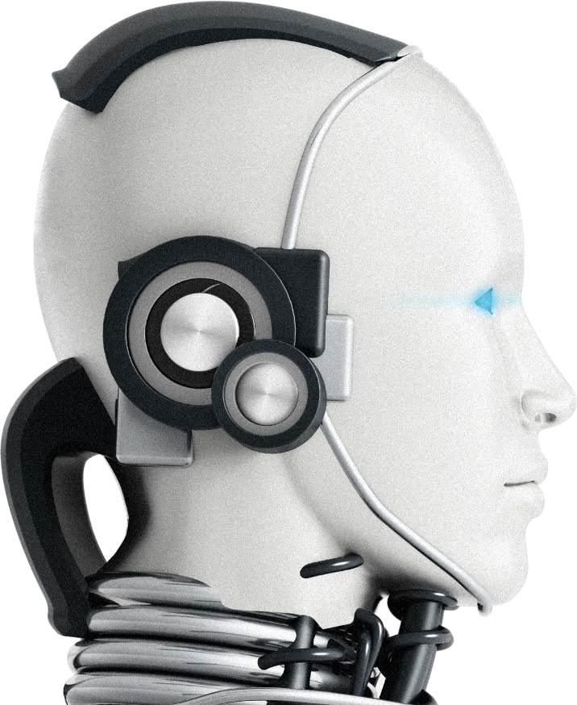
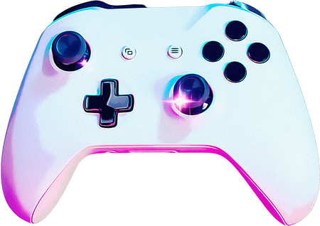

Thank You
Any Questions?

